Slide 1
Genscan predicted gene exon
Official gene exon

Slide 4
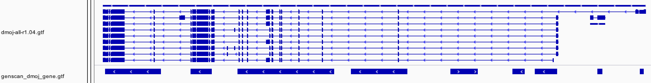
Genscan predicted gene region
Official gene region
Official gene regions
Predicted gene regions

Slide 5

Shorter predicted size that the official gene

Slide 6
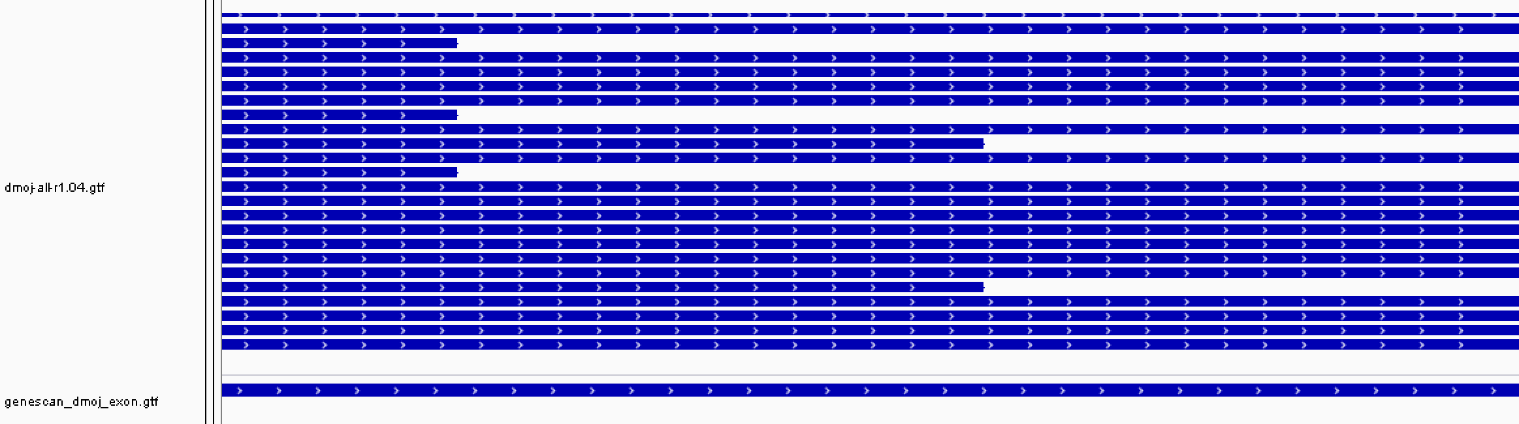
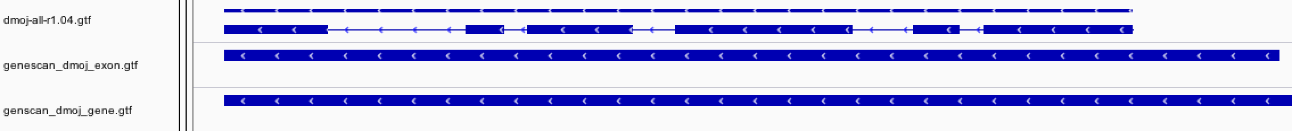
Case 1
Case 2

Slide 8


Slide 9
dgri
12058 genscan predicted exon map more than one exon in the reference, while only 427 exon map more than one exon in the genscan output

